Slide 1


EN2091 - Analog Project
Guitar Headphone
Amplifier
Waveform Wizards

Slide 2
What is a guitar headphone amplifier?
Usually, the electric guitar doesn’t include a headphone amplifier. We cannot hear the original sound of the guitar. However, this guitar headphone amplifier is an alternative solution for this.

Slide 3
Operation of the circuit
The electric guitar has the output of a small electrical signal. typically it is around 600 mV.(peak to peak value) There is no power to drive the headphones.
This amplifier will amplify the output of this small electrical signal and output is given to a headphone output. The gain also can be adjustable.
Power rating
- Average - 9 mW
- Maximum - 36 mW

Slide 4
Main Components
Here we are using the OPA134PA the OPAMP as the main component of the circuit. Other than that we use the following components.
Resistors
Polarized capacitors
BC547(npn) & BC557(pnp) transistors
Potentiometer
9V battery
6.35mm and 3.5,mm audio jack bases

Slide 5
Components selection
Specifications of OPA134
Operating voltage - 5V to 36V
Gain Bandwidth Product - 8 MHz
Slew rate - 20 V/us
Input bias current - 100 pA (+ or -)
Noise Voltage - 1.2 Vrms
Noise Density - 8 nV/(Hz)^(1/2)

Slide 6
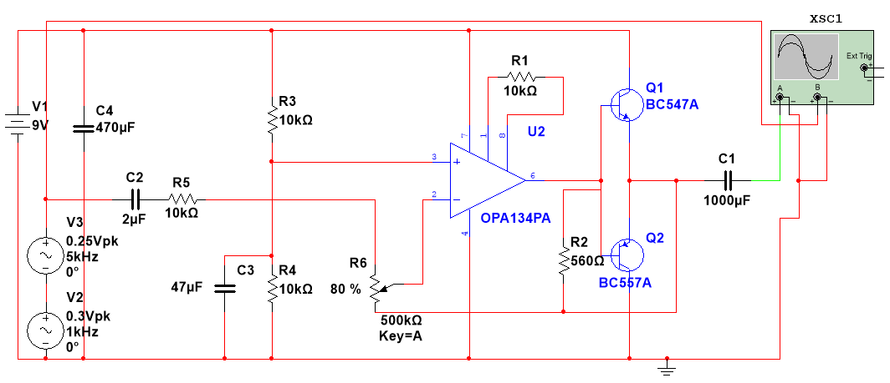
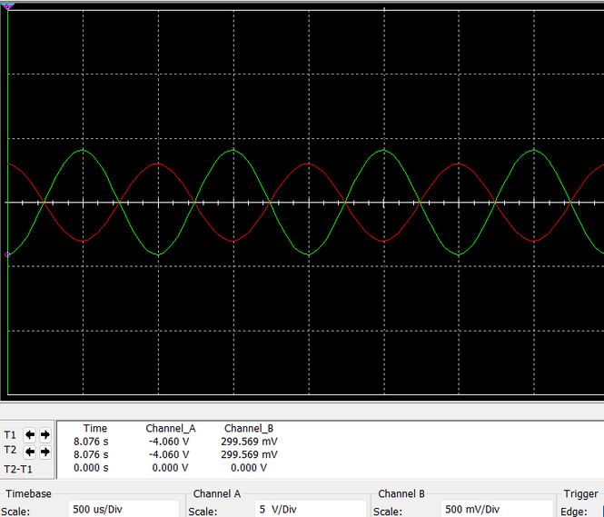
Simulation of the circuit
signal output
signal input

Slide 7
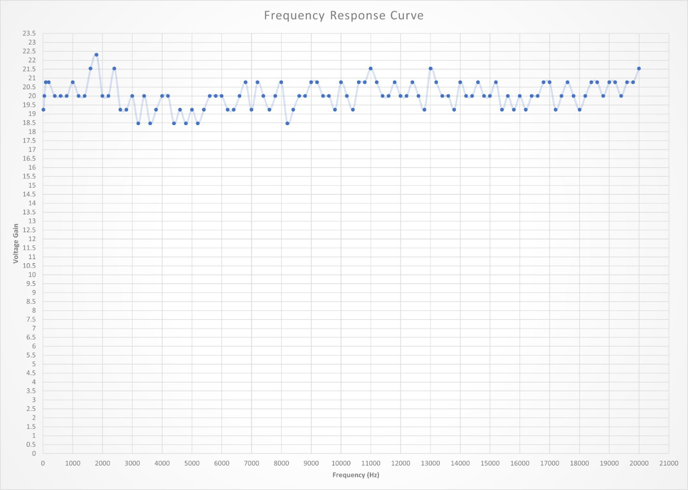
Frequency response curve

Slide 8
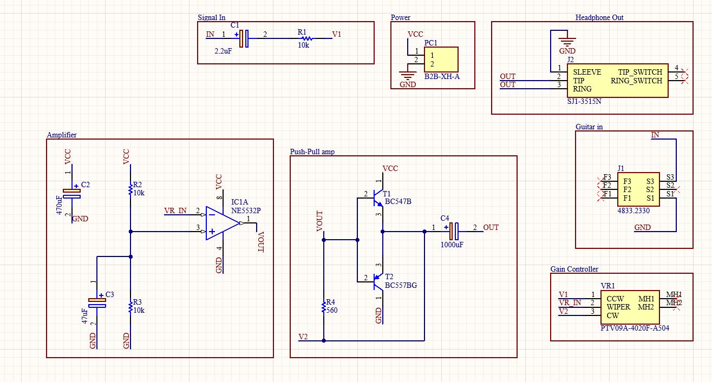
PCB Schematic

Slide 9
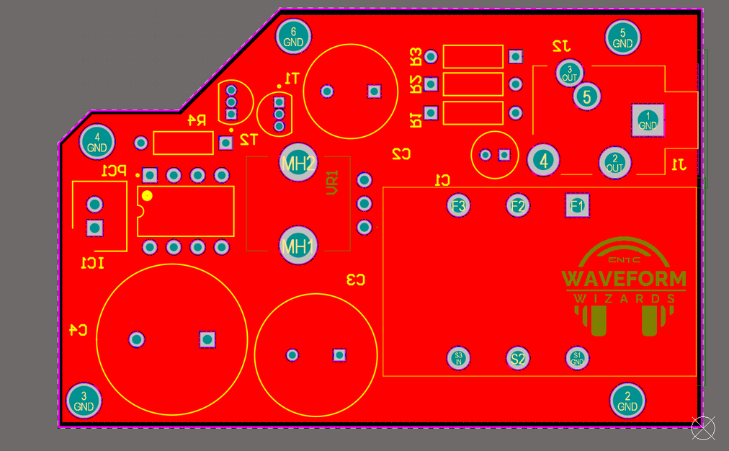
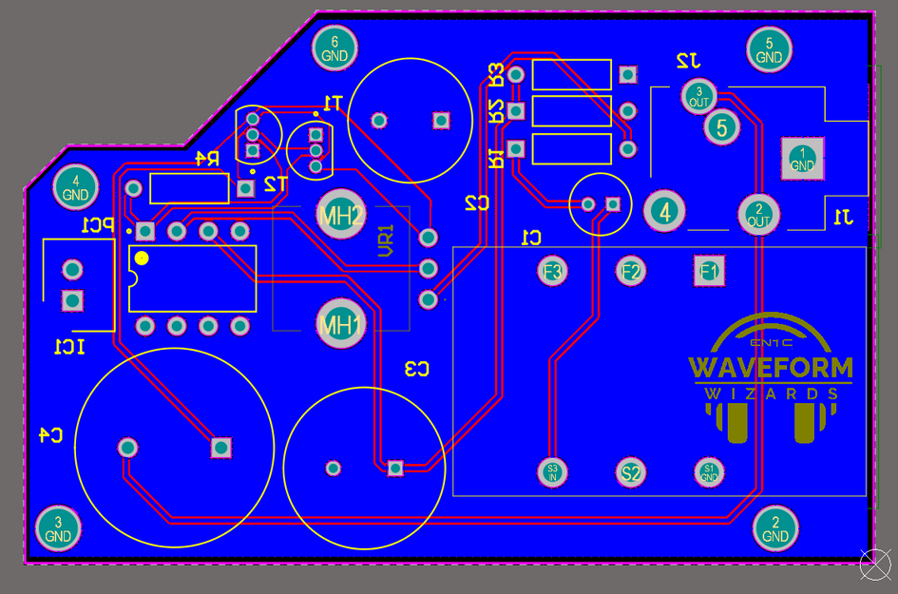
PCB Design (Final)
Two-layer PCB
Through-hole components
Top Layer
Bottom Layer

Slide 10
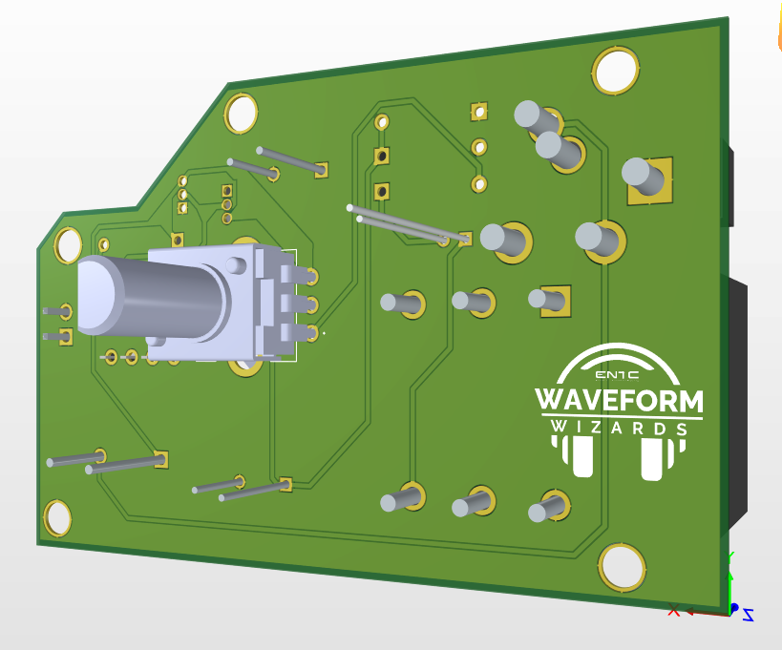
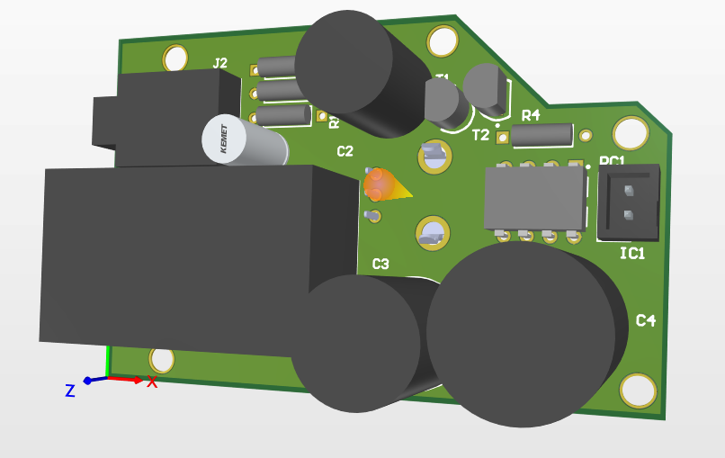
PCB Design (Final)
Two-layer PCB
Through-hole components
3D Model

Slide 11
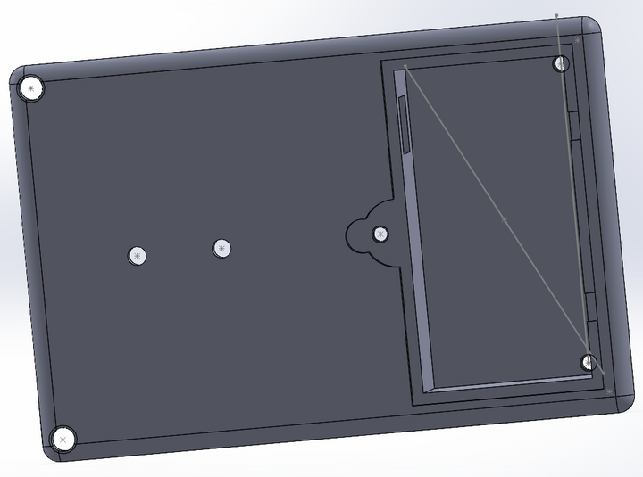
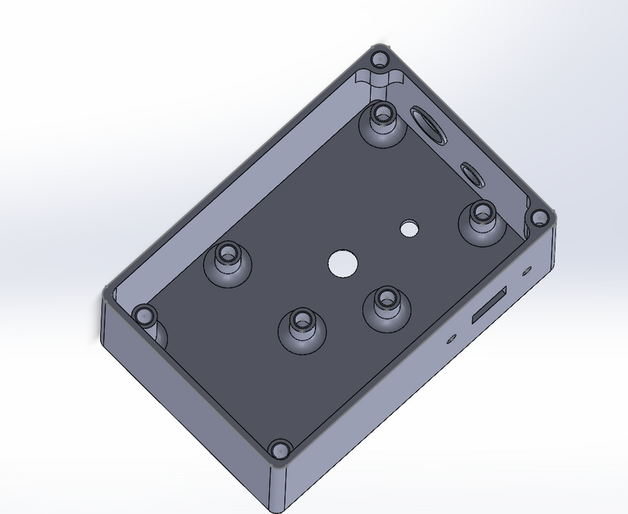
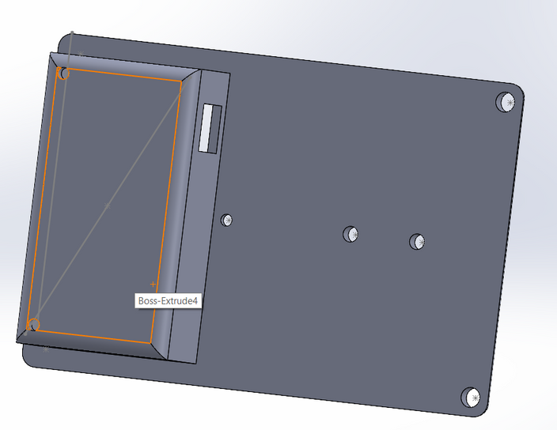
Enclosure Design
Box
lid

Slide 12
LET’S MOVE ON TO THE DEMOSTRATION

